Slide 1







Capstones project 1(Networking)

Slide 2
Analyse the following packets
Task 1

Slide 3


Questions
For PCAP 1
Which protocol was used over port 3942?
What is the IP address of the host that was pinged twice?
How many DNS query response packets were captured?

Slide 4
Alexis is a fictional cybersecurity company with thousands of employees. An attacker has gained unauthorized entry into its premises and has connected their laptop to an unused port on a switch. The attacker now has access to the company’s internal networks. Within the internal network, there is a central server where critical proprietary data is stored. In this capture, the attacker is attempting to collect SSH credentials that they can use to log into the central server.
Task 1

Slide 5
Questions
What is the MAC address of the attacker?
What is the type of attack which is taking place that allows the attacker to listen in on
conversations between the central server and another host?
What is the file which was downloaded from the central server?
What department does Borden Danilevich work in?
What is the SSH password of the Domain Administrator?

Slide 6
Create a Python algorithm to remove the following users from the allowed.txt file. Remove_fellow = [‘111’, ‘112’]
Task 2

Slide 7



01
Introduction to Intrusion Detection Systems

Slide 8



Incident Response
Incident Response (IR) refers to managing and addressing security breaches or cyberattacks.
Minimize the impact of an attack and restore operations efficiently.

Slide 9

Intrusion Detection With Suricata
Network intrusion detection with Suricata

Slide 10
What we will be covering
Introduction to Suricata
Installing & configuring Suricata
Suricata rules
Suricata configuration file
Writing custom Suricata rules
Network intrusion detection with Suricata

Slide 11
Introduction to Suricata
Suricata is a free and open-source threat detection engine. It does this by combining IDS, IPS and network security monitoring.
Suricata is owned and developed by the community-run non-profit organization OSIF (Open Information Security Foundation).
GitHub Repo: https://github.com/OISF/suricata
Suricata has 2 main operational modes
Active (IPS) – Used to alert, log and block network traffic that matches specific rules.
Passive (IDS) – Used to identify, alert and log suspicious network traffic within a network.

Slide 12
How Suricata works
Suricata can be deployed as an IDS on a network to monitor network traffic or as an IPS in in-line mode to detect and stop malicious network traffic.
Suricata utilizes a set of predefined rules or rule-sets to identify malicious network traffic.
When malicious network traffic is detected and is matched against a rule or set of rules and alert will be generated and the traffic will be logged.
Similar to Snort, these logs can then be imported or relayed to a SIEM like Splunk for live security event monitoring.

Slide 13
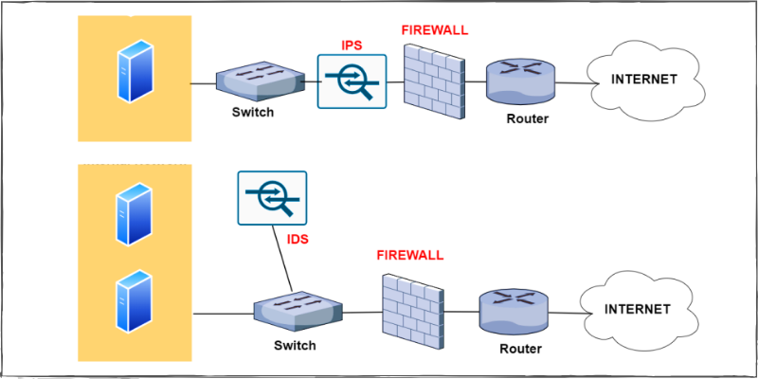
Suricata IDS network placement

Slide 14
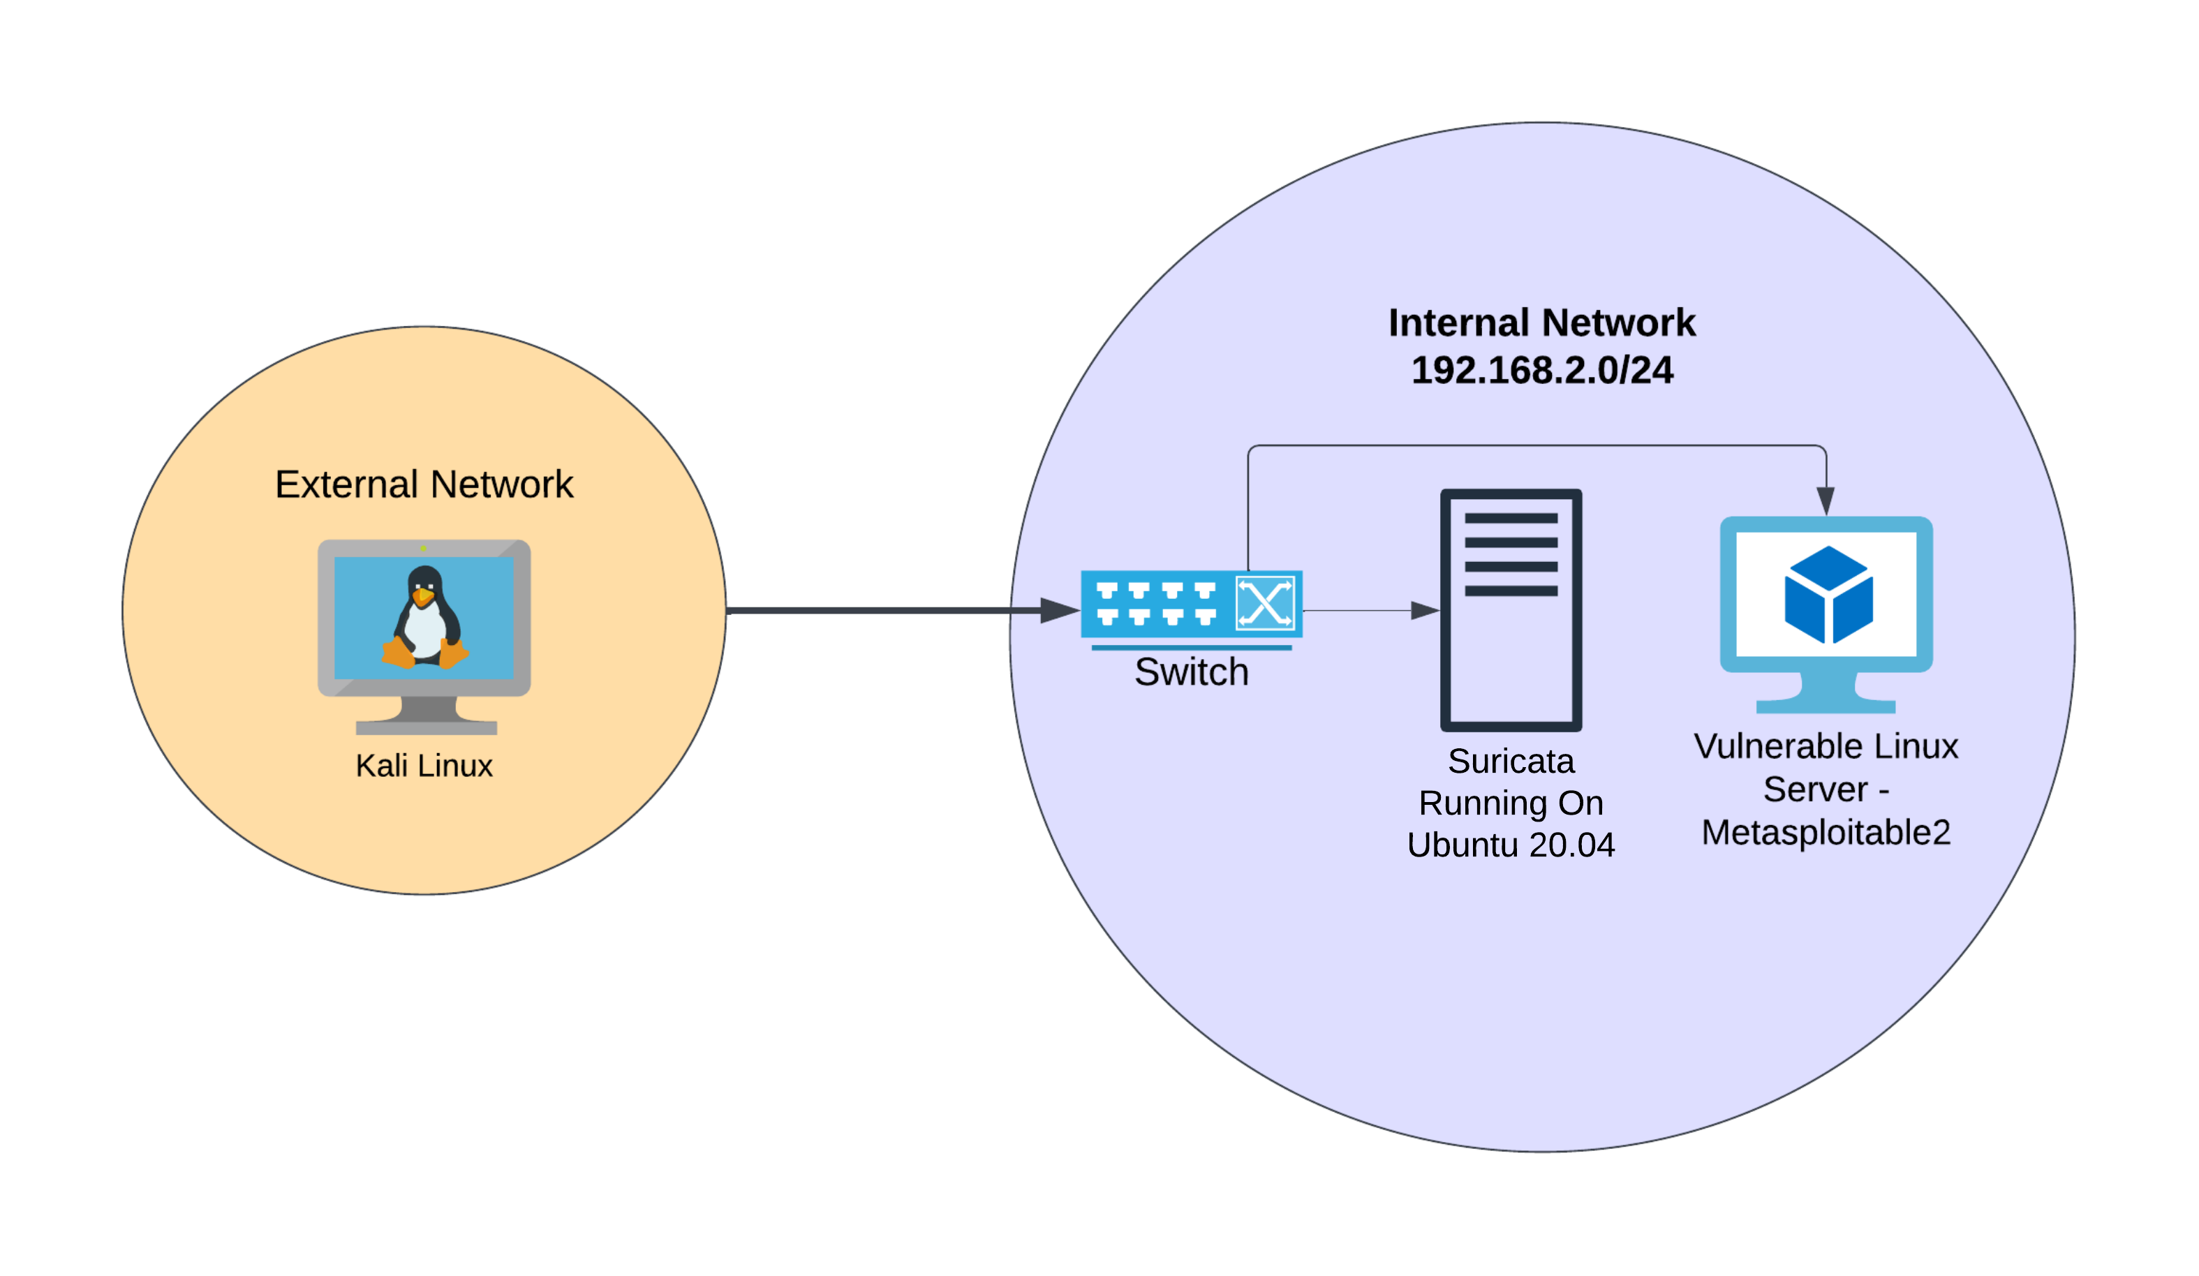
Lab environment

Slide 15
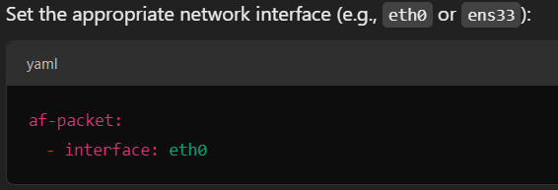
Incident Response
sudo apt install suricata
Sudo mousepad /etc/suricata/suricata.yaml

Slide 16
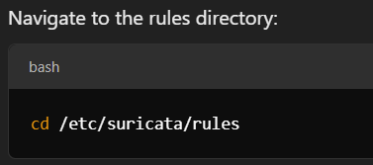
Incident Response
sudo apt install suricata
Sudo mousepad /etc/suricata/suricata.yaml

Slide 17
Importance of Incident Response
Minimize Impact: Rapid and efficient response reduces damage to systems, data, and reputation.
Meet Regulatory Requirements: Compliance with standards (e.g., GDPR, NIST).
Operational Continuity: Keeps businesses functional even during a cyber incident.
Cost Efficiency: A well-prepared response reduces financial damage caused by downtime, data breaches, and lawsuits.

Slide 18
Key Concepts in Incident Response
Threat Vectors: How attackers infiltrate systems (e.g., phishing, malware, DDoS, insider threats).
Indicators of Compromise (IoC): Warning signs of an attack (e.g., unusual network traffic, unauthorized access).
Security Information and Event Management (SIEM): Tools used for real-time monitoring and analysis of security alerts.

Slide 19

02
Intrusion Detection With Snort

Slide 20
Intrusion Detection Systems (IDS)
Intrusion detection is the process of actively discovering threats/attacks/intrusions on a network, hosts or services.
There are 2 types of IDS solutions based on the placement, a host-based IDS (HIDS) is setup on an individual host on a network and a network IDS (NIDS) is placed within a network to monitor traffic to and from all hosts on a network.
An IDS is a system/host planted within a network to capture traffic and identify malicious activity based on predefined rules, after which, this malicious activity is logged, and a notification is sent to the relevant parties informing them of an intrusion.
Intrusion detection systems are typically coupled with the functionality to also perform intrusion prevention, whereby specific rules can be set to drop packets that are malicious or intrusive.

Slide 21
Introduction to Snort
Snort is a popular free and open-source IDS/IPS system that is used to perform traffic/protocol analysis, content matching and can be used to detect and prevent various attacks based on predefined rules.
Snort has been active development and has thousands of users and contributors that develop rules to keep Snort up to date with the latest attacks.
Snort has 3 main operational modes
Packet Sniffing – Collects and displays network traffic like what Wireshark does.
Packet Logging - Collects and logs network traffic into a file.
Network intrusion detection – Analyzes packets and matches traffic against signatures

Slide 22
Introduction to Snort
Snort detects malicious traffic or attacks by leveraging pattern matching.
When active, Snort captures packets, reassembles them, analyzes them and determines what needs to be done to the packet based on predefined rules.
Snort rules are very similar to a typical firewall rule, whereby, they are used to match network activity against specific patterns or signatures and consequently make a decision as to whether to send an alert or drop the traffic (in the case of IPS).
Snort has a large amount or rule-sets created by the community that are very useful to begin with.

Slide 23
Snort rules
Snort has 3 types of rules/rule-sets:
Community rules - Free rule-sets created by the Snort community.
Registered rules – Free rule-sets created by Talos. In order to use them, you must register for an account.
Subscription only rules – These rule-sets require an active paid subscription in order to be accessed and used.
Or… we can write our own rules based on your requirements.

Slide 24
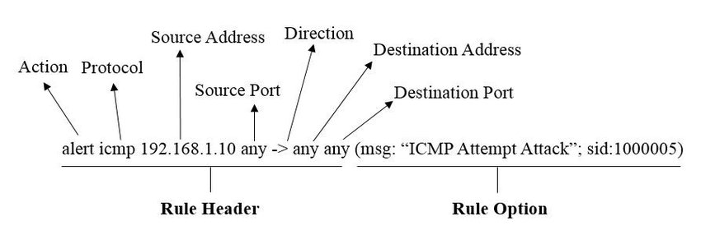
Snort rule syntax

Slide 25
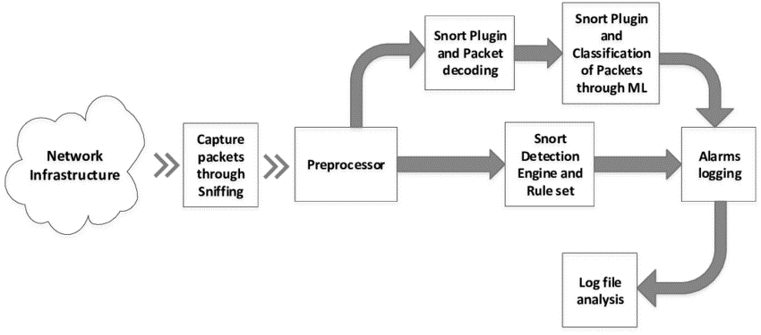
How Snort works

Slide 26
How UFW Improves Network Security
UFW acts as a barrier between the internal network and external traffic.
It enforces access control policies, allowing only trusted traffic and services while blocking potential threats.

Slide 27

Default deny
By setting the default rule to deny all incoming traffic, UFW ensures that no unsolicited or unwanted traffic can enter the network unless explicitly allowed.
This acts as a baseline defense against unauthorized access

Slide 28
03
Practical Exercise

Slide 29
Installation
- sudo apt update
- sudo apt install ufw -y
- sudo ufw enable
ifconfig

Slide 30

sudo ufw default deny incoming

Slide 31
Summary of UFW
Access Control: Restricts access to services based on IPs and ports.
Port Filtering: Reduces exposure by blocking unnecessary services.
ICMP Management: Prevents ping floods and network scans.
Default Deny Policy: Blocks all incoming traffic unless explicitly allowed, ensuring only authorized access.
Ease of Use: UFW simplifies the management of security policies without compromising on robustness.
By implementing UFW, organizations can effectively harden their network perimeter,
protecting it from intrusions and unauthorized access while maintaining control over
legitimate traffic.

Slide 32
Thanks!
Do you have any questions?
amosmarvellous48@gmail.com
+234 702 625 4613

